Slide 1
Visualize This!
Using R in Introductory Statistics Courses
Notes:
Statistics is about informing our world with data. It starts with data, ends with data. How we communicate starts with understanding the nature of data; and this is done primarily through visualization.

Slide 2

Teaching Statistics: Start With the Data
Image and other content provided by “the Open Knowledge Foundation” by creative commons license
https://blog.okfn.org/2013/10/03/defining-open-data/
Notes:
In an introductory course, it is useful if we present students with a wide variety of data - from various industries and interests. Thanks to the efforts of many, there is a growing movement to make data open to the public and free to use.

Slide 3
No Installation Required – Why R ?
Fast becoming the most utilized tool in statistical analysis
Costs nothing to use
Considered to be the best visualization tool
Growing user support and development community
Data literacy
Lots of Code Examples require no programming expertise
Notes:
In academic settings, it is our job as educators not only to teach the subject, but also to give students an opportunity to work with tools that are used in "the real world". These are just a few reasons to incorporate R into an introductory statistics course.

Slide 4
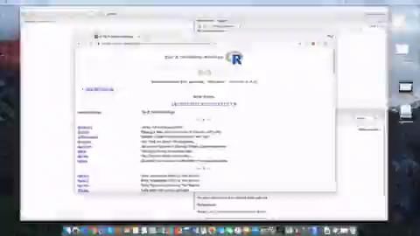
Notes:
(press play)

Slide 5
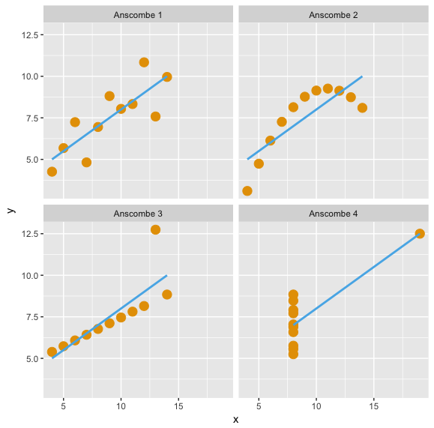
Anscombe’s Data Plots in R
Notes:
What is the purpose of these four data sets? Answers may vary, but certainly to illustrate that not all bivariate data can be linearly modeled, despite a high correlation

Slide 6
Anscombe’s Quartet – Results of Linear Regression
Property | Value | R code
Mean of x | 9 | mean(anscombe$x1)
Sample variance of x | 11 | var(anscombe$x1)
Mean of y | 7.50 | mean(anscombe$y1)
Sample variance of y | 4.125 | var(anscombe$y1)
Correlation between x and y | 0.816 | cor(anscombe$x1, anscombe$y1)
Linear regression line | y = 3.00 + 0.500x | R Code Block
Coefficient of determination of the linear regression | 0.67 | R Code Block
Repeat these for x1, x2, x3, x4 and y1, y2, y3, y4
Notes:
We can't simply rely on statistics calculations; what we do with data needs to be justified, explained, and assumptions matter!

Slide 7
DatasauRus
More Fun With Nonlinear Data

Slide 8
DatasauRus Dozen Activity
R Code
jupyter notebooks
Copy-Paste
Click “Run”
Save Image
Image plots
Drag to desktop
Discuss
More time for discussion in class
Snippets
png file
Built-in
RStudio
Notes:
Details of where to find these things is at the end of the presentation. But this gives us a way to share with colleagues and students.
Snippets: https://rdrr.io/snippets/
jupyter notebooks: https://rnotebook.io/anon/77500e35422c9834/notebooks/datasauRus_dozen_plots.ipynb

Slide 9
away
bullseye
circle
dino
dots
h lines
high lines
slant down
slant up
star
v lines
wide lines
x shape
Each of these has the same regression parameters
Notes:
The datasauRus dozen actually consists of a baker's dozen (13) complete data sets that are highly recommended for fun. They also contain some interesting features.

Slide 10
R Code Blocks – Anscombe Data
# The following will produce the 4 plots which
# can be exported in a single image file
x <- c(anscombe$x1,anscombe$x2,anscombe$x3,anscombe$x4)
y <- c(anscombe$y1,anscombe$y2,anscombe$y3,anscombe$y4)
dataset <- c(1,1,1,1,1,1,1,1,1,1,1,2,2,2,2,2,2,2,2,2,2,2, 3,3,3,3,3,3,3,3,3,3,3,4,4,4,4,4,4,4,4,4,4,4)
anscombe1 <- as.data.frame(cbind(x,y,dataset))
names(anscombe1) <- c("x", "y", "dataset")
anscombe1$dataset <- factor(anscombe1$dataset,levels = 1:4, labels = sprintf("Anscombe %s",1:4))
ggplot(anscombe1, aes(x=x, y=y)) +
geom_point(color='#E69F00', size = 4) +
geom_smooth(method=lm, se=FALSE, color = '#56B4E9') + facet_wrap(~dataset, ncol=2)

Slide 11
R Code Blocks – Anscombe Data
# Using the anscombe data, find the regression lines
# and related summary statistics
require(stats); require(graphics)
summary_data <- summary(anscombe)
ff <- y ~ x
mods <- setNames(as.list(1:4), paste0("lm", 1:4))
for(i in 1:4) {
ff[2:3] <- lapply(paste0(c("y","x"), i), as.name)
mods[[i]] <- lmi <- lm(ff, data = anscombe)
print(anova(lmi))
}
regression_coeff <- sapply(mods, coef)
print(regression_coeff)
lapply(mods, function(fm) coef(summary(fm)))

Slide 12
References – Where To Find Materials
Anscombe’s Quartet: Anscombe, F.J. (1973). "Graphs in Statistical Analysis". The American Statistician. The American Statistician, Vol. 27, No. 1. 27 (1) pages 17-21. JSTOR 2682899. doi:10.2307/2682899
To create the visualizations using the “Datasaurus Dozen” the R Code is in a jupyter notebook and is publicly available. Please take care NOT to alter the code: https://rnotebook.io/anon/77500e35422c9834/notebooks/datasauRus_dozen_plots.ipynb
Snippets is an online, web-based tool that allows one to run R code and create visualizations in the browser. Graphs and plots can be dragged to the desktop and will save as an image file (.png) https://rdrr.io/snippets/
R Datasets package: https://stat.ethz.ch/R-manual/R-devel/library/datasets/html/00Index.html
R programming language is free and installed via “precompiled binary distributions”; click on “Download R for (Mac) OS X” or “Download R for Windows” as appropriate from this site: http://cran.utstat.utoronto.ca/
Rstudio is a more user-friendly way of working with R. You need to download R first, then Rstudio Desktop: https://www.rstudio.com/products/rstudio/download/
Want to learn as an absolute beginner? Try this free online introduction: https://www.datacamp.com/courses/free-introduction-to-r
DataCamp Classroom is FREE: https://www.datacamp.com/groups/education

